Slide 1


Career Compass
AI-Based Career Guidance Platform
Presented by: Tushar Thakur | Course: BCA | Institution: DAV College
Project Type: Final Year Project | Roll no: 8004

Slide 2

Introduction
Career Compass is a modern, web-based platform purpose-built to help students make well-informed, confident career decisions. Rather than relying on overloaded counsellors or one-size-fits-all advice, it delivers a personalized, data-driven experience tailored to each student's unique profile.
Personalised Guidance
Data-Driven Approach
Automated Process
Career recommendations based on individual academic performance and personal interests
Structured analysis replaces guesswork with accurate, evidence-based suggestions
Eliminates dependency on manual counselling, saving time for students and institutions alike
Goal: To simplify career decision-making using automation and technology.

Slide 3

Problem Statement
Students face multiple challenges when choosing careers:
Key Challenges
Resulting Impact
No Clear Direction
Wrong Career Choices
Students lack structured awareness of available career options and their own aptitude
Students enter fields misaligned with their strengths and passion
Generic Advice
Most guidance is broad and impersonal, failing to account for individual strengths
Lower Satisfaction
Mismatched careers lead to disengagement and burnout
Limited Access
Professional counsellors are scarce, expensive, or simply unavailable to many students
Reduced Productivity
Long-term professional performance suffers without a purposeful start

Slide 4
Objectives of the Project
Career Compass was designed with five clear, measurable objectives that together form a comprehensive solution to the career guidance gap faced by today's students.
01
02
03
Personalized Recommendations
Automate Guidance Processes
Efficient Data Management
Deliver tailored career suggestions based on each student's unique academic record and declared interests
Replace time-consuming manual counselling with intelligent, automated workflows that respond instantly
Store, retrieve, and manage student profiles and assessment data in an organized, accessible format
04
05
Quick Decision-Making
Scalable Architecture
Ensure rapid, accurate output so students receive actionable guidance without delay
Build a system flexible enough to accommodate future enhancements, additional features, and growing user bases

Slide 5
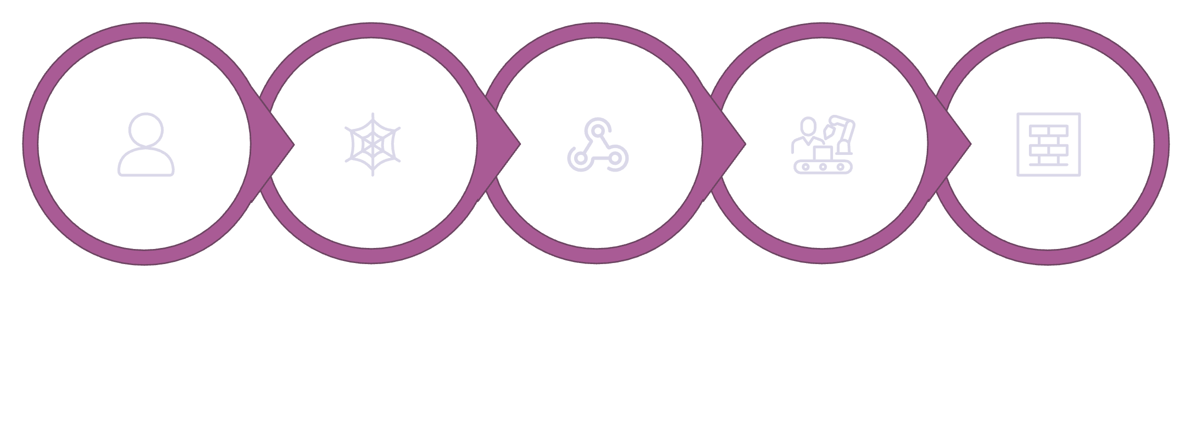
System Overview
The Career Compass system is divided into three main components:
🖥️ Frontend
⚙️ Backend Automation
🗄️ Database
An intuitive web interface built with HTML, CSS, and JavaScript through which students register, log in, and complete their career assessments
Make.com serves as the logic engine — receiving webhook data, applying conditional rules, and routing information intelligently
Google Sheets acts as a cloud-based, real-time data store for user profiles, assessments, and generated career recommendations
Working Flow
User
Website
Webhook
Make.com
Google Sheets
This architecture ensures real-time processing and smooth user experience.

Slide 6
Technologies Used
The system uses a combination of modern technologies:
HTML
CSS
Structure and layout of web pages
Styling and responsive design
JavaScript
Make.com
Form validation and dynamic behaviour
Workflow automation and logic handling
Google Sheets
Webhooks
Cloud-based database
Communication between frontend and backend
Advantage: Lightweight, scalable, and easy to maintain system.

Slide 7

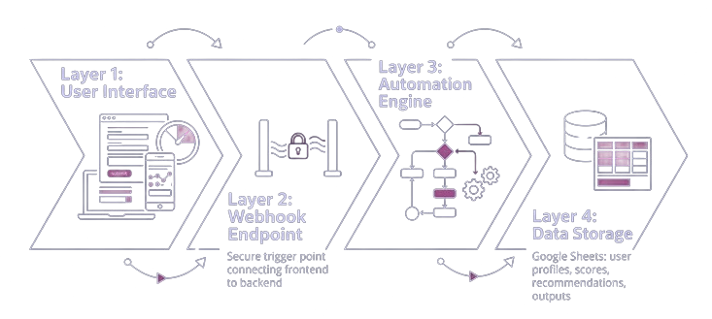


System Architecture
Career Compass follows a client-server-style architecture implemented entirely through modern automation tools — eliminating the need for a traditional dedicated server. Each layer communicates seamlessly to deliver a reliable, end-to-end experience.
Data Flow
User Input
Web Interface
Webhook
Automation
Database
Output
This ensures efficient and organised data processing.
Data travels through each layer sequentially: user input is captured on the frontend, transmitted via webhook, processed by the Make.com automation engine, stored in Google Sheets, and the resulting career recommendation is returned to the user — all within seconds.

Slide 8

Workflow of the System
The Career Compass workflow is designed to be intuitive for the student while sophisticated under the hood. From first login to final recommendation, every step is automated, validated, and logged — ensuring consistency and accuracy throughout.
Registration & Login
User creates an account or logs in with existing credentials
Credential Validation
System verifies user identity before granting access to assessment tools
Assessment Completion
Student completes a structured questionnaire covering academic scores and personal interests
Data Transmission
Responses are sent securely to the backend via a configured webhook endpoint
Processing & Recommendation
Make.com applies logic, generates a tailored career recommendation, and returns it to the user
Result: A smooth and automated user journey from input to output.

Slide 9

Automation Using Make.com
Make.com serves as the entire backend engine of Career Compass — a powerful no-code automation platform that replaces traditional server-side programming. It listens for incoming data, applies business logic, and coordinates all responses without a single line of backend code.
Key Benefit
By leveraging Make.com, the project eliminates the need for traditional backend development — no Node.js, no PHP, no server management. This dramatically reduces complexity, accelerates development time, and lowers hosting costs while maintaining full automation capability.
Webhook Reception
Router & Multi-Flow Handling
Instantly receives and parses student form data from the frontend
No backend coding required — Make.com handles all logic, routing, and data management out of the box
Directs data through different logic paths based on student inputs and scenarios
Conditional Logic
Database Write & Response
Validates inputs and applies rules to determine the most appropriate career output
Writes results to Google Sheets and returns the final recommendation to the student

Slide 10
Data Management
Google Sheets serves as the cloud-native database powering Career Compass. Its simplicity, real-time sync capabilities, and zero-cost deployment make it an ideal choice for an academic project that demands reliability without infrastructure overhead.
What Gets Stored
Why Google Sheets?
User Profiles
Login Records
Registration details and account information
Securely logged credential and session data
Real-Time Updates
Data is written and read instantly with no delays or caching issues
Assessment Scores
Recommendations
Academic performance and interest evaluation results
Generated career paths and guidance outputs per user
Anywhere Access
Accessible from any device or location with a Google account
Cost-Effective
Free to use with no database hosting or maintenance fees

Slide 11
Key Features of the Career Guidance System
A robust, full-stack solution built to streamline career decision-making for students through intelligent automation, intuitive design, and enterprise-grade reliability.
Automated Recommendations
Student Interface
AI-driven career suggestions tailored to each student's academic profile
Clean, intuitive UI designed for ease of use without technical knowledge
Admin Panel
Real-Time Processing
Centralised dashboard for data oversight, management, and configuration
Live data handling ensures instant, accurate career output for every query
Secure Login
Scalable Architecture
Validated authentication protects student data and system integrity
Flexible system design supports future growth and feature expansion

Slide 12
Testing & Quality Assurance
Rigorous testing was conducted across all system layers to validate reliability, data accuracy, and end-to-end workflow integrity before deployment.
Testing Methods
Outcomes Achieved
1
Unit Testing
✅ Accurate Results
Validated individual form fields, input rules, and submission logic to ensure each component behaved correctly in isolation
Career recommendations matched expected outputs consistently across all test cases
2
Integration Testing
Verified seamless communication between Make.com automation workflows and Google Sheets, ensuring data passed accurately between systems
✅ Smooth Data Flow
No data loss or corruption detected during transfer between frontend and backend services
3
Functional Testing
✅ Zero Major Errors
Simulated complete student journeys from form submission through to career recommendation output, validating the full workflow
All critical paths passed without failure; minor issues were identified and resolved during iteration

Slide 13



Challenges Faced & Key Learnings
Building a real-world automation system presented significant technical obstacles — each of which became a powerful opportunity for growth and deeper understanding of modern web architecture.
Frontend–Automation Integration
Real-Time Data Transfer
Codebase & Debugging
Bridging the gap between the HTML frontend and Make.com automation required careful mapping of data fields, webhook configurations, and error handling protocols
Ensuring consistent, low-latency data transmission without loss or duplication demanded precise trigger logic and thorough scenario testing within Make.com
Managing a growing codebase while debugging webhook responses required structured version control and systematic troubleshooting methodologies
🔁 Workflow Automation
🔗 API & Webhooks
Mastered scenario-based automation using triggers, filters, and routers
Gained hands-on experience designing and consuming RESTful integrations
🏗️ System Design
🧩 Problem-Solving
Applied practical architecture principles to build a maintainable solution
Developed resilience and analytical thinking under real project constraints

Slide 14
LOOKING AHEAD
Future Scope & Enhancements
The current system establishes a strong foundation. The roadmap below outlines high-impact enhancements that will transform this into a comprehensive, AI-powered career intelligence platform.
Phase 1
1
AI Career Prediction — Integrate machine learning models to provide personalised, data-driven career path predictions based on student profiles
2
Phase 2
Power BI Dashboards — Embed interactive analytics for administrators to monitor trends, track usage, and derive institutional insights
Phase 3
3
LinkedIn Integration — Connect student profiles with LinkedIn data to enrich recommendations with real-world industry alignment
4
Phase 4
Job Recommendations — Surface live job listings matched to each student's recommended career field and skill level
Phase 5
5
Mobile Application — Launch a dedicated iOS and Android app to make career guidance accessible anytime, anywhere

Slide 15
Conclusion
This project demonstrates that a well-designed, automation-powered system can meaningfully simplify career decision-making for students at scale.
✅ System Delivered
⚙️ Process Automated
Successfully designed, built, and deployed a fully functional career guidance system from concept to completion
Eliminated manual decision-making by automating the full career recommendation workflow end-to-end
🔗 Seamlessly Integrated
📈 Built to Scale
Unified the HTML frontend with Make.com and Google Sheets for a cohesive, responsive data pipeline
Delivered an architecture that is flexible, maintainable, and ready for future growth and enhancement
Thank You
We appreciate your time and attention. We welcome any questions, feedback, or suggestions.

